Slide 1
AI SW For Diagnosis Of Cardiovascular Diseases
Team 2
Computer Science Department

Slide 2
Our Team
Dr.Bassant M.Elbagouty
TA.Lamis Hassan
Associate Professor Of Computer Science Department
Tutorial Assistant Of Software Engineering Department
Alaa Ahmed
Sulieman Snossy
Karim Ali
Team Leader
Computer Science Department
Team Member 2
Computer Science Department
Team Member 3
Computer Science Department
Aya Hesham
Amira Ayman
Team Member 4
Computer Science Department
Team Member 5
Computer Science Department

Slide 3
Table of contents
01
04
02
05
03
06
Introduction
Datasets
Objective
Solutions
Problem Definition
Conclusions

Slide 4
01
Introduction
Democratizing expert cardiac care through medical-grade AI and cloud technology to provide high-quality cardiac care to patients regardless of their location or financial situation.

Slide 5
02
Objective
Our goal is to create an algorithm using DL techniques to diagnose and predict CVDs with high accuracy, thus providing early diagnosis and increasing accuracy compared to existing models.

Slide 6
03
Problem Definition
Based on the data from the World Health Organization, nearly 17 million deaths are due to cardiovascular diseases, which ranks first among all diseases.

Slide 7
Issues Of Diagnosis
Confusion of symptoms
Not be effective in predicting
Free of noise
Number of people are small
Single-lead ECG susceptible to interference

Slide 8
04
Dataset
ECG is effective and non-invasive in diagnoses CVDs.
Deep learning algorithms need huge data to train so we used is different for each disease.

Slide 9
Datasets
MIT-BIH NSRDB
St. INCARTDB
Normal
Fs 128Hz , ECG1, ECG2 , 18 , 24h
CAD
Fs 257Hz , II,VI ,7 ,30 min
PTBDB
BIDMC CHFDB
MI
Fs 1000Hz , II,VI ,148 , 2 min
CHF
Fs 250Hz , ECG1, ECG2 , 15 ,20 h

Slide 10

System Architecture

Slide 11
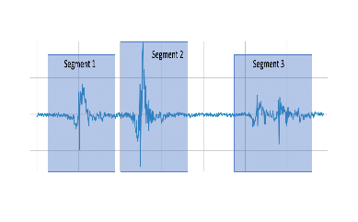
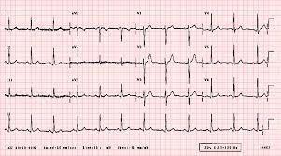

Dataset Collection ECG Data
Understanding Domain Data
ECG Data Preprocessing
Segmentation
Obtain Results(Accuracy, Precision, Recall)
Training Deep Learning Multi-Classifier Model
Removing Noises
ECG Feature Extraction
User Interface Layer
Compare & Predict
User Interface Development & System Integration
Predicted Output
Mobile Application

Slide 12
05
Solutions
Based on the data from the World Health Organization, nearly 17 million deaths are due to cardiovascular diseases, which ranks first among all diseases.

Slide 13
17,498,300
Deaths Of Cardiovascular Diseases

Slide 14
Solutions
First Approach
Second Approach

Slide 15

First Approach
CR-Former Model
The advantages of combines Convolutional Neural Networks(CNNs),Transformer, and ResNet.
CResFormer uses CNNs to extract high-level features from ECG signals , ResNets are used to improve the flow of information and prevent vanishing gradients during training . and Transformer Encoder to capture the temporal dependencies between the ECG signal segments

Slide 16
First Approach
01
02
03
Data Preparation
Model Training
Results

Slide 17
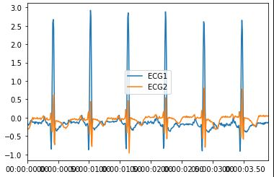
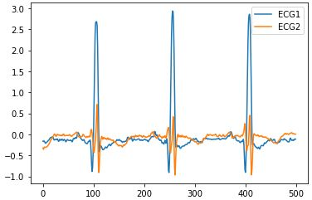
01
Data Preparation
The CR-Former model takes the segmented ECG signals from two leads as input, which are not preprocessed or denoised. The model does not require any signal processing operations before inputting the data.
Resample

Slide 18
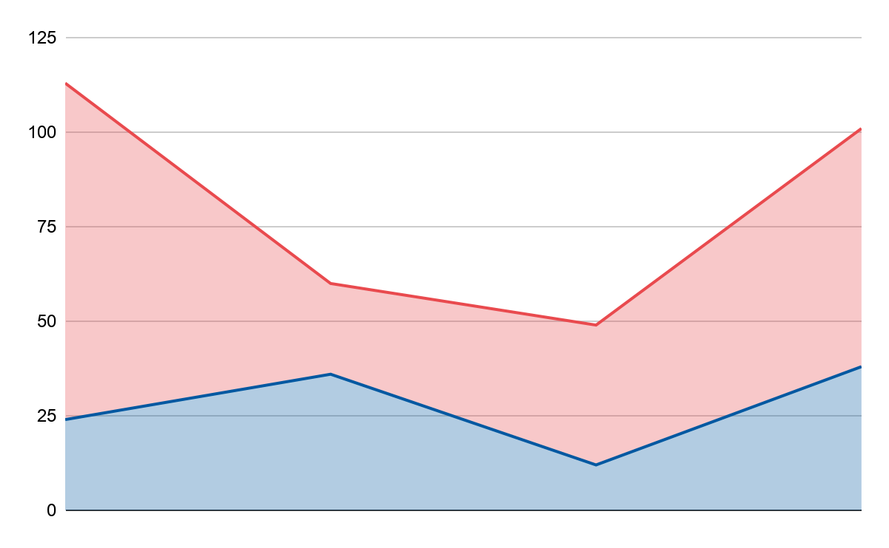
Data Split
Prevalence
Evolution
80%
Train
20%
Test
Train
Test

Slide 19
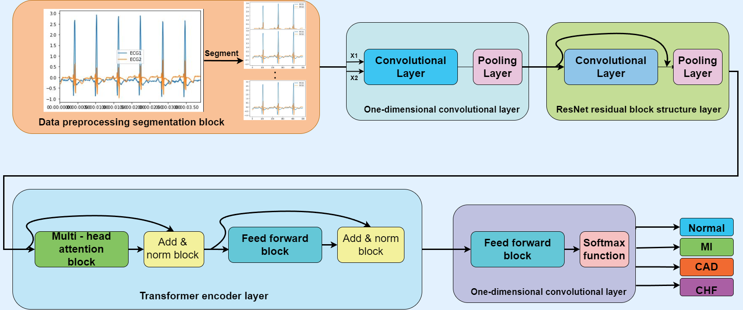
02
Model Training

Slide 20
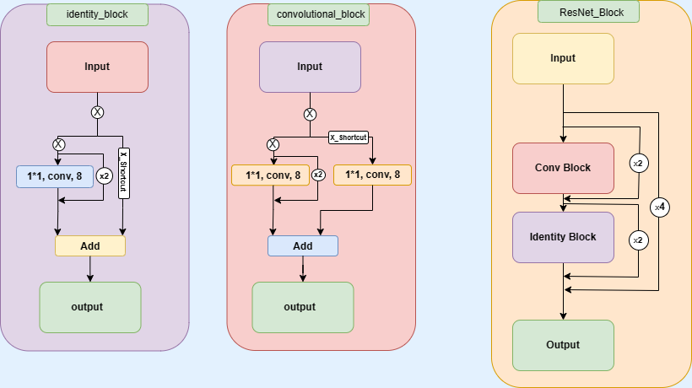
Resnet Residual Block

Slide 21
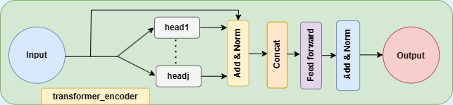
Transformer Encoder Architecture

Slide 22
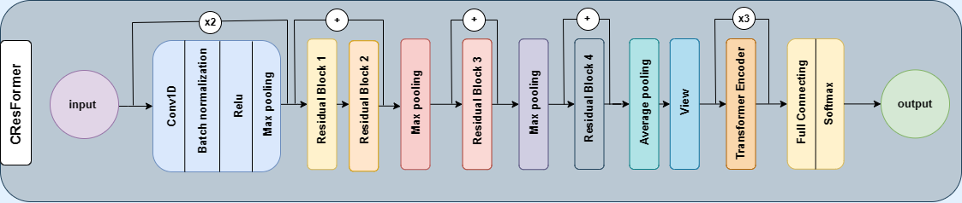
CResFormer Model Architecture

Slide 23
Information Of Training And Testing Datasets

Slide 24
03
Results

Slide 25
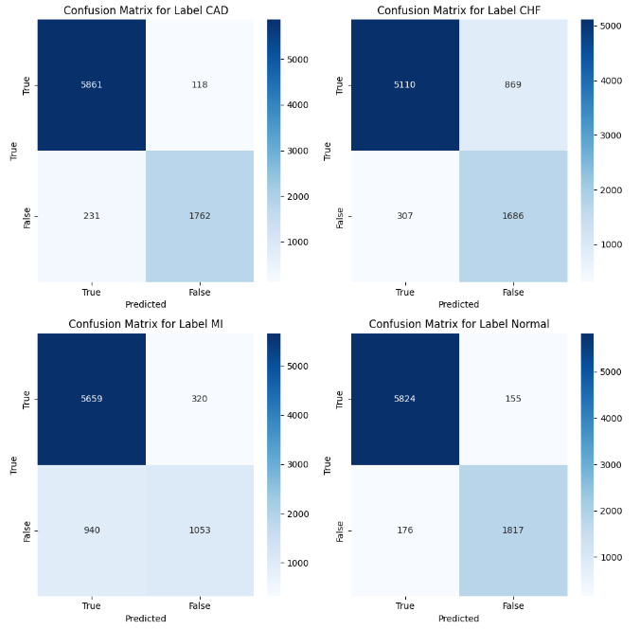
Confusion Matrix

Slide 26
Second Approach
The purpose is to build training and testing datasets for classification using ECG signals from different databases.
The code extracts heartbeats from the ECG signals and balances the number of samples for each class to avoid class imbalance.

Slide 27
Second Approach
01
02
03
Data Preparation
Model Training
Results

Slide 28
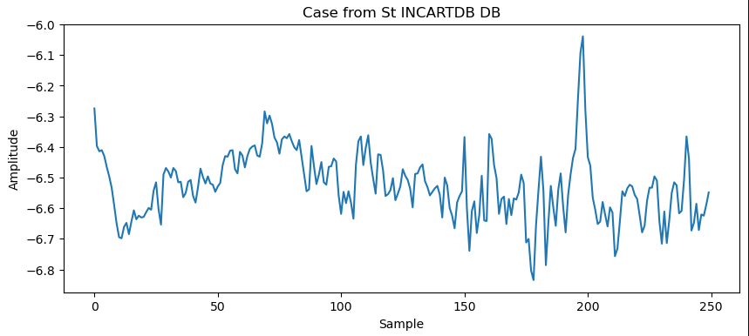
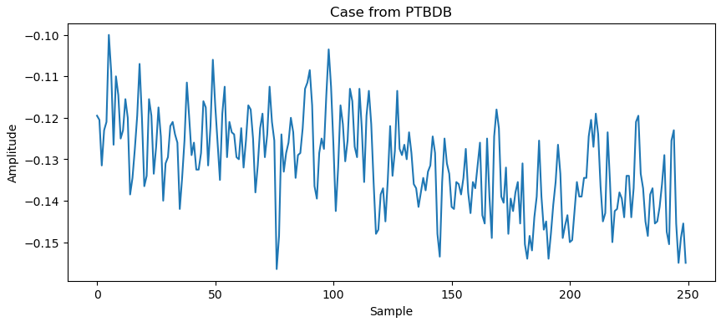
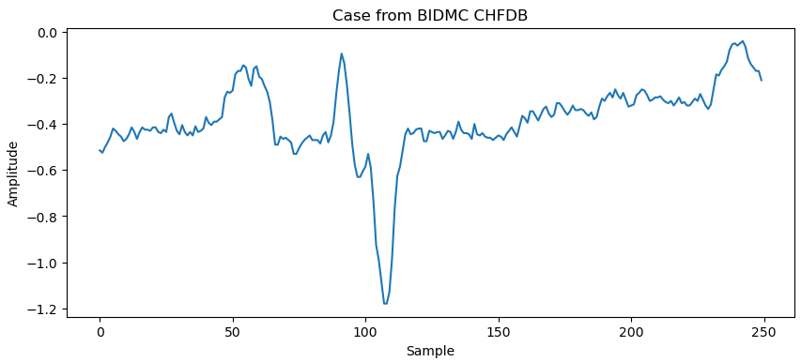
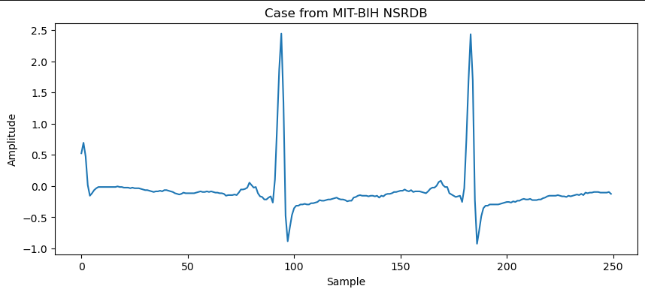
01
Data Preparation

Slide 29
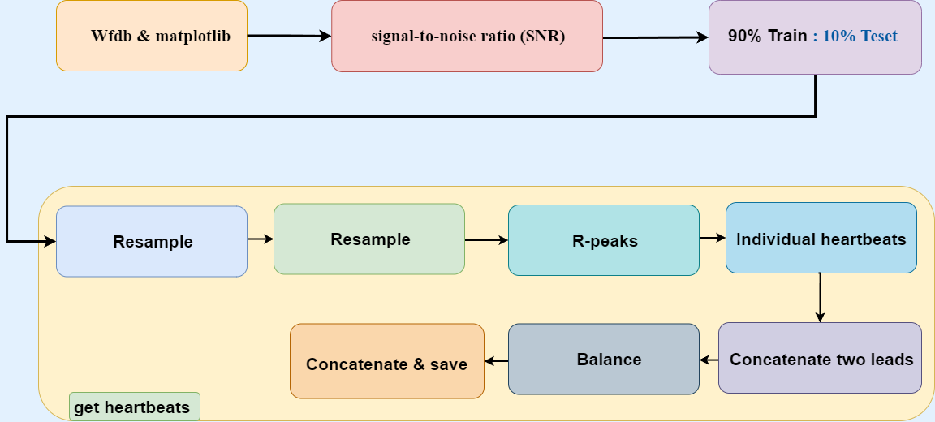
Data Pre-Processing
Notes:
1- Load and visualize example ECG signals from different databases using wfdb for load & matplotlib for visualize.
2- To check needing of filtering in preprocessing by calculate signal-to-noise ratio (SNR) of the ECG signal.
SNR is a metric determine level of noise in signal
If the SNR is low, then filtering may be necessary to improve the accuracy
Additionally, if the signal is to be used for classification tasks, filtering may be necessary to remove any noise that could interfere with the classification process.
3- For each disease select 90% from cases for train and 10% for test
4- Get heartbeats from signal by
Resample the ECG signal to a consistent sampling rate 250 Hz using linear interpolation
Detect R-peaks in an ECG signal using the Pan-Tompkins algorithm.
Segment ECG signal into individual heartbeats with window size = 200
Concatenate two leads
Balance the number of samples for each class
Concatenate the balanced data frames for each fold and test data and save as a gzipped csv file

Slide 30
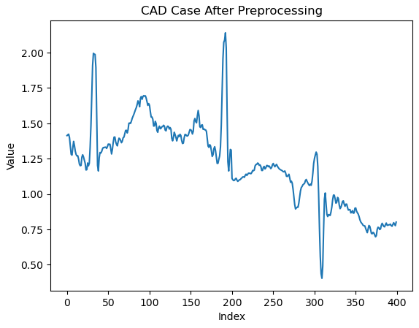
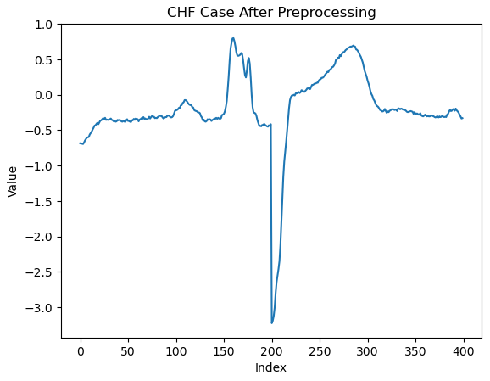
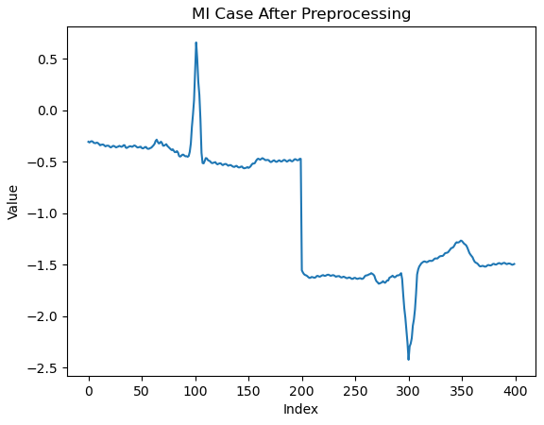
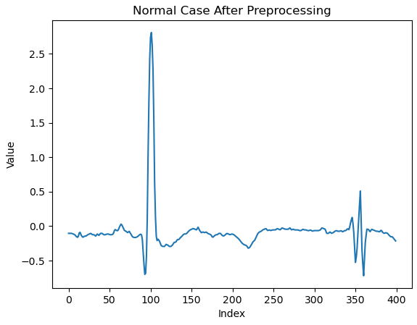
After Pre-Processing

Slide 31
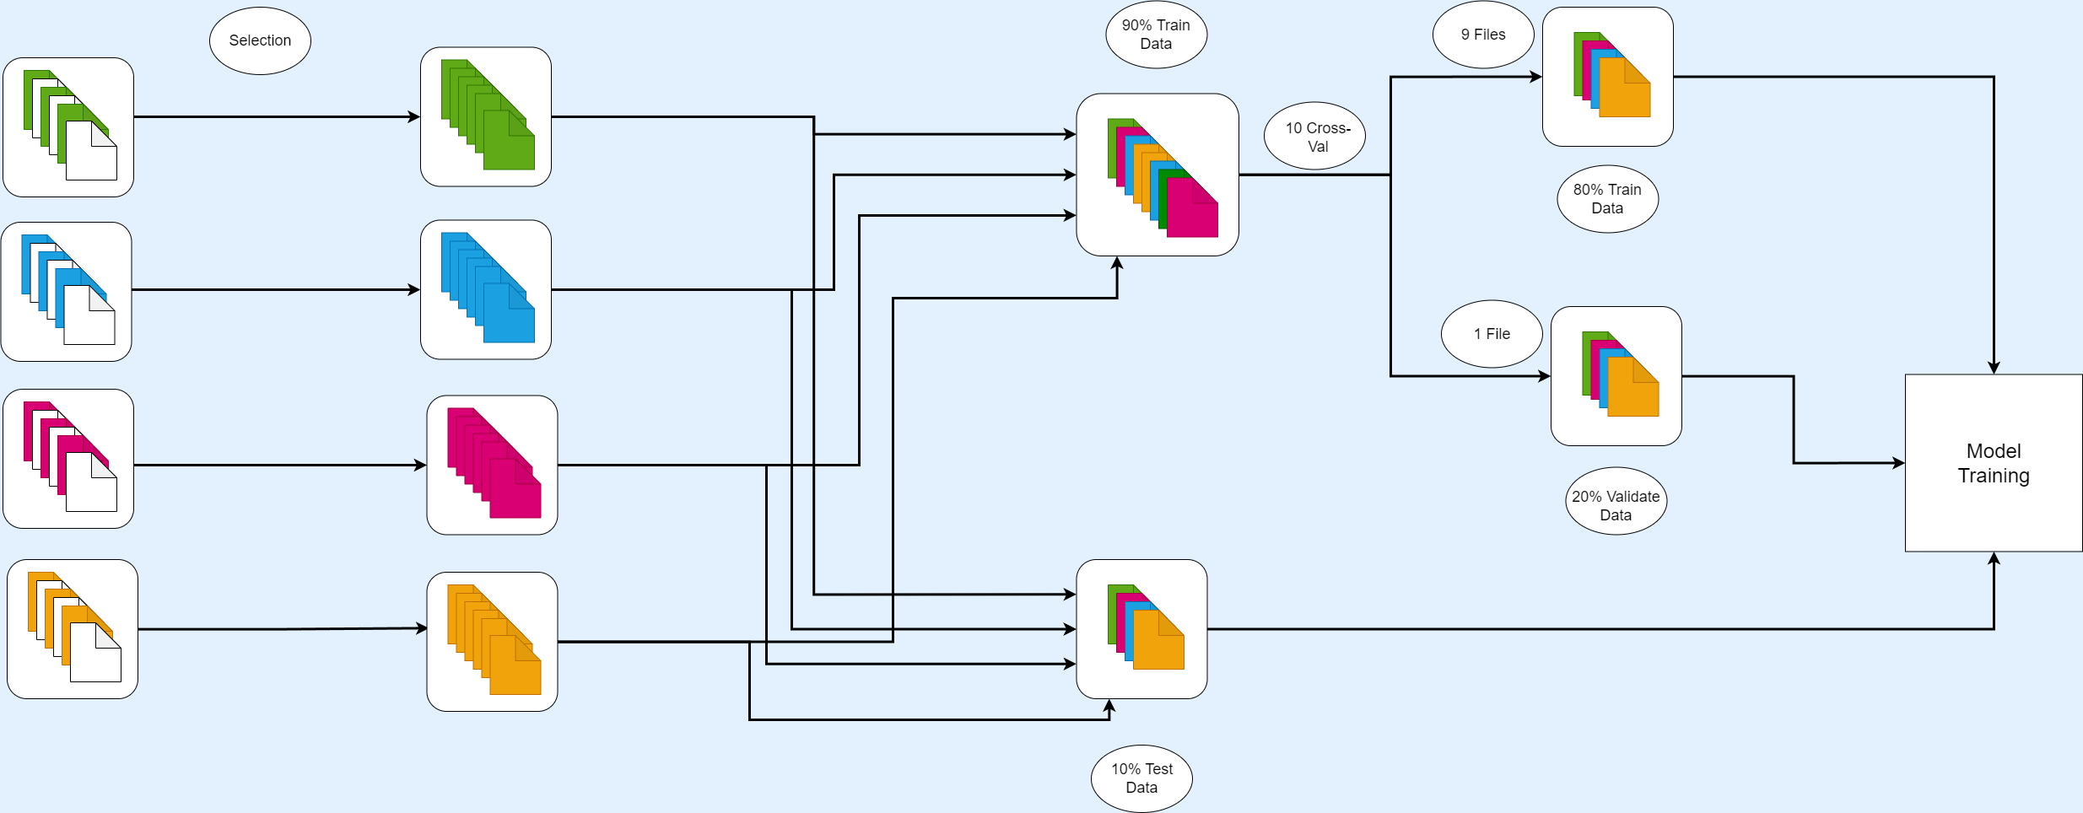
Data split

Slide 32
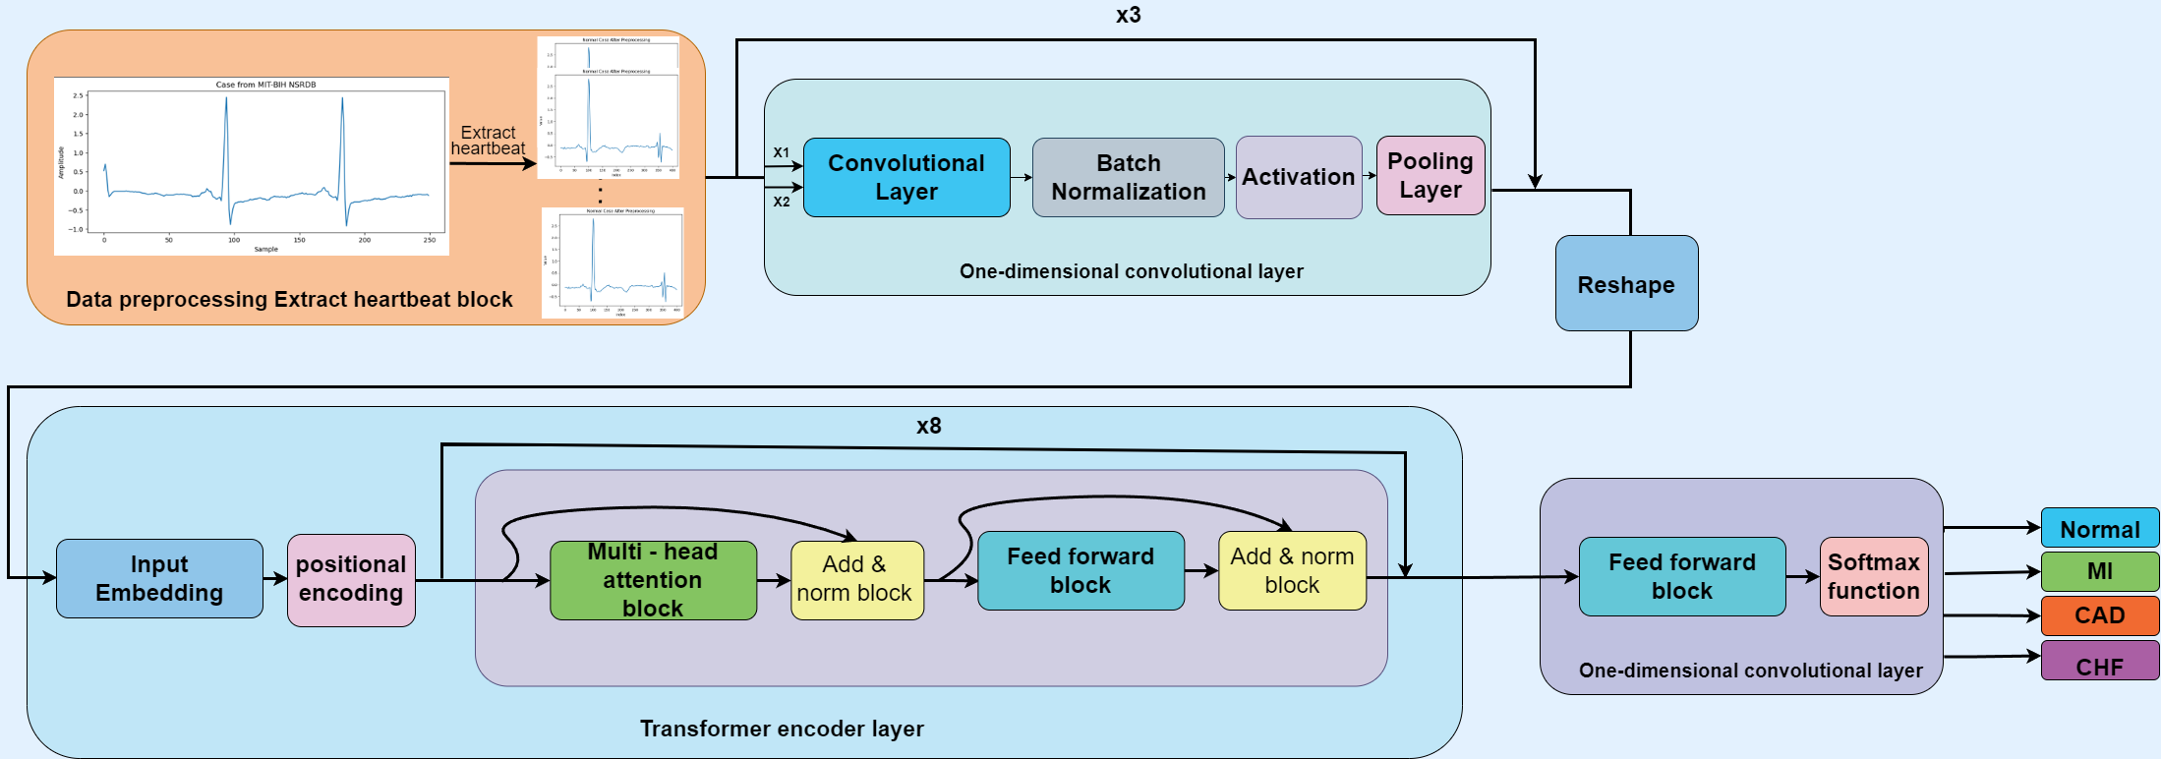
02
Model Training

Slide 33
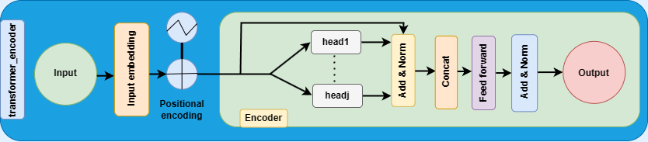
Transformer Encoder Architecture

Slide 34
03
Results

Slide 35
Classification Report

Slide 36
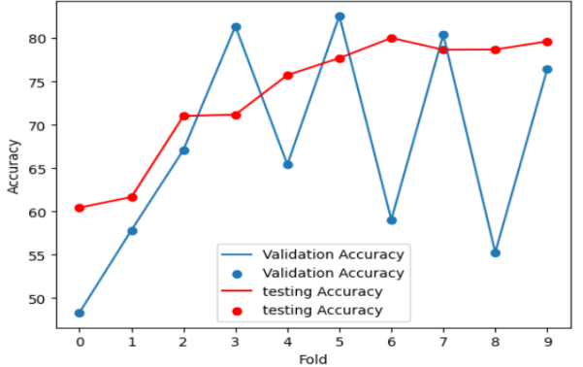
Validation Accuracy Vs Fold Vs Testing Accuracy

Slide 37
Experimental results Vs. Literature studies
 | Author | Year | Accuracy
CNN coupled with LSTM | Lih et al | 2020 | 96.51%
Multilevel discrete wavelet transform densely network (MDD-Net) | Zhang et al | 2020 | 97.67%
Proposed | - | 2023 | 98%

Slide 38
Conclusion
06
Demo
Future Work
References

Slide 39
Website Demo

Slide 40
APP Demo

Slide 41
Take Assesment Demo

Slide 42
Auth Demo

Slide 43
Future Work
Optimizing the model's algorithm complexity.
Enhancing the comprehensiveness of the information by using more leads.
More generalization with actual ECG signal data from hospitals obtained
in different environments.

Slide 44
References
Mhamdi; Dammak; Cottin; Dhaou, I.B. Artificial Intelligence for Cardiac Diseases Diagnosis and Prediction Using ECG Images on Embedded Systems. Biomedicines 2022, 10, 2013 ; Published: 19 August 2022.
Furqan Rustam;Abid Ishaq;Kashif Munir;Mubarak Almutairi;Naila Aslam and Imran Ashraf .Diagnostics 2022;15 Jun 2022,12(6), 1474.Incorporating CNN Features for Optimizing Performance of Ensemble Classifier for Cardiovascular Disease Prediction.
Mehmood, A., Iqbal, M., Mehmood, Z., Irtaza, A., Nawaz, M., Nazir, T., & Masood, M. (2021). Prediction of heart disease using deep convolutional neural networks. Arabian Journal for Science and Engineering, 46(4), 3409-3422.
R. P. Lippmann, Pattern classification using neural networks, IEEE Commun. Mag., vol. 27, no. 11, pp. 47–50, 1989.

Slide 45
Our Team
Alaa Ahmed
Karim Ali
Aya Hesham
Suleiman Snossy
Amira Ayman

Slide 46
THANK YOU!
Does anyone have any questions?

